Slide 1
You are here . . .
An introduction to your place in space
Adam Johnston
Weber State University
ajohnston@weber.edu
Notes:
Slides compiled and annotated by Adam Johnston at Weber State University, Department of Physics. Contact me at ajohnston@weber.edu for more info.

Slide 2
A few details . . .
We live on a planet (Earth) . . .
That goes ‘round a star (Sun) . . .
that’s part of a galaxy . . .
that’s within a single universe.
Notes:
I think it’s important to get a sense of which things are which, so you can start to get a sense of scale. Each thing is a container of sorts for another.

Slide 3
A few other details . . .
If our galaxy has about 100,000,000,000 stars, and our universe has about 100,000,000,000 galaxies, we’ve got about 10,000,000,000,000,000,000,000 possible places to live. (10²² stars)
There are a few good questions to ask at this point:
How do we know that?
Where does all this stuff come from?
Where does it all go? And how?
Notes:
This is another way to frame all the different containers. In short, there’s a LOT of space and a LOT of places. We’re just on one of them, and even when our Earth and solar system seem big, they’re really small in the great context of it all.

Slide 4
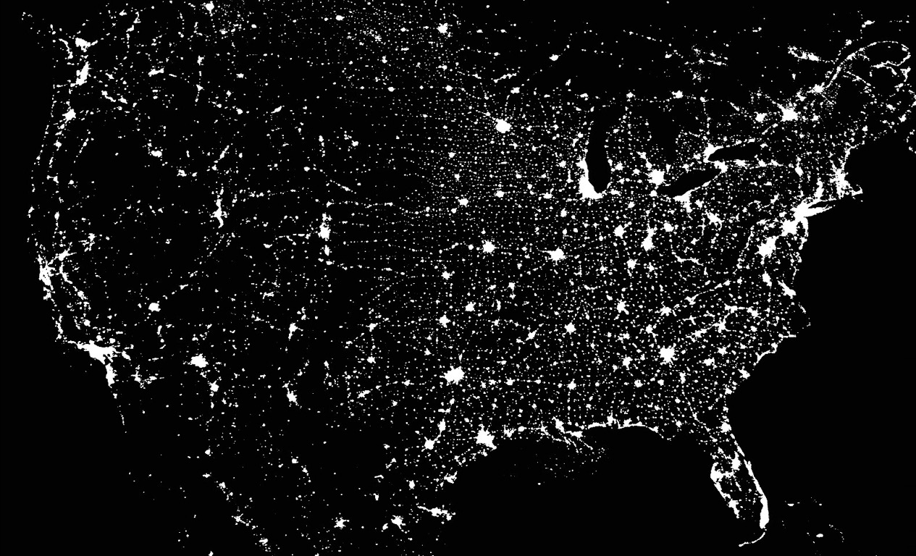
You are here . . .
Notes:
This is a composite image that shows all of the light we produce on our own. All of the “borders”, outlines, and locations you see are identified only by the actual lighting. What can you see? What does this mean in terms of how we view the sky? For more information, you should investigate the International Dark-Sky Association: http://www.darksky.org/ (None of the light you see is necessary, since it’s just bleeding out into space. This shows us how wasteful most of our lighting is. This is also the cause of light pollution, which makes it so that you can’t see as many stars as you should be able to in your night sky, especially in cities.)

Slide 5
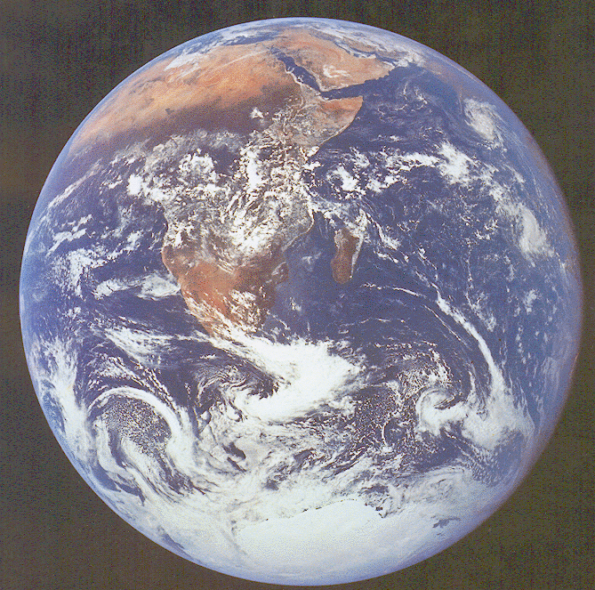
. . . on a pale blue dot.
Notes:
Obviously, this is Earth as viewed from space. What do you notice? Particularly important for our lives and our planet’s hospitality is the fact that you have water in all three phases. What evidence do you have for this? Why is this a big deal? What kinds of conditions are important for this to be possible? How rare or likely do you think these conditions are?
The Earth is spherical. How does this determine what we see of space? How does this change with time of day? With season? As we move from one place to another? (You could experiment with this by using Sky View Cafe or other planetarium tools. You could also measure the length and direction of a shadow as day progresses.)

Slide 6
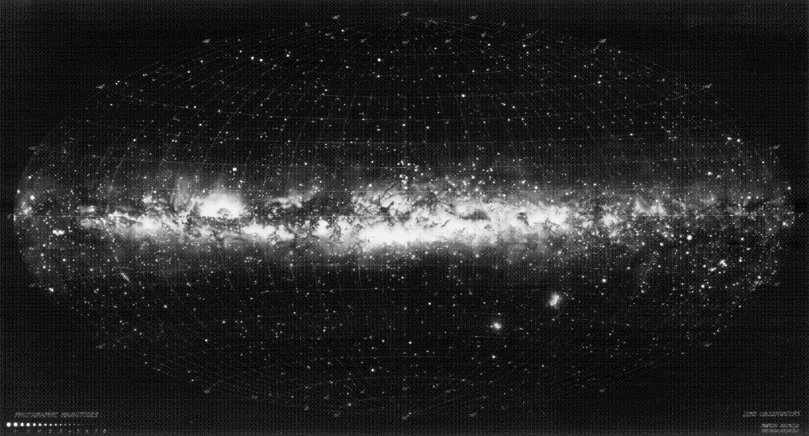
The view from here.
Notes:
This is a projection of the ENTIRE sky, made into a map just like a globe could be made into a wall map. It’s oriented to align with the “Milky Way”. What does this tell you? We say that the Milky Way is our own galaxy. What does an image like this tell us about our island or metropolis of stars -- where are we in this arrangement, and how do you know? (i.e., we must be part of some kind of disk of stars, with an especially dense portion in the center. We’ll look at other galaxies later to help verify what this might look like.)

Slide 7
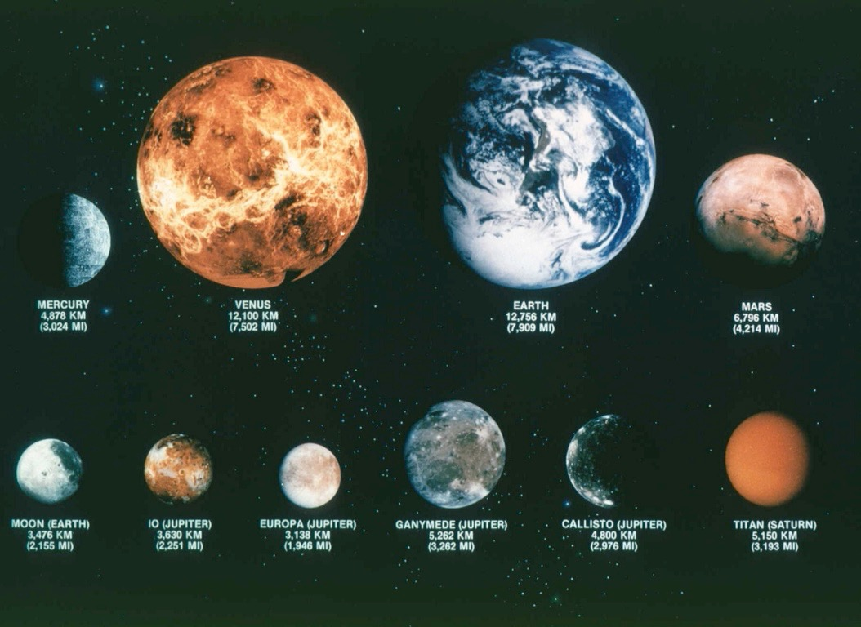
A family portrait
Notes:
Terrestrial (Earth-like) planets are usually identified as Mercury, Venus, Mars, and, of course, Earth. But there are plenty of other objects in our solar system that are terrestrial. What characteristics do they have? Why do we care? If you’re looking for life on other planets or in other star systems, what conditions would you look for?
Also, yu might point out that Earth is particularly unique: It has liquid water and an atmosphere that isn’t too think nor too thin. It turns out that you need the right temperature to sustain an atmosphere like this, and you need this atmosphere to have liquid water. It’s a nice place we live on.

Slide 8
Notes:
A Mars lander pokes around. Why do we care about Mars? (Even though Venus might be more similar in size to Earth, its atmosphere is so much thicker that its temperature ran away and is now always the temperature of a super hot pizza oven.) Mars has temperatures that are colder, and its atmosphere is much thinner, but there’s good evidence that it used to have liquid water along with an atmosphere. We’re interested in finding the evidence for what this water was like, and we’re even interested in figuring out whether or not life could have existed on Mars. If it did, it was probably much different than what we have here on Earth.)

Slide 9
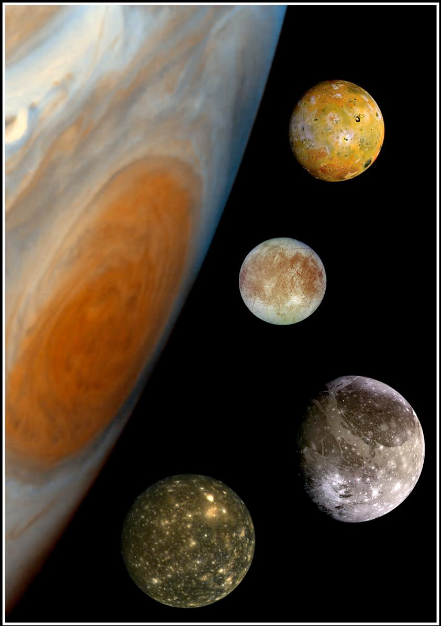
Notes:
While these distances aren’t to scale, this portrait of Galilean Moons of Jupiter shows you a bit about the scale of both Jupiter and these satellites. This shows us both how big Jupiter is (and its Great Red Spot, an ongoing storm in its turbulent gas composition), and how interesting these moons can be. It doesn’t matter if you aren’t called a planet, you still have interesting possibilities worth studying. For example, Io, at the top, is very volcanic, mostly because Jupiter pulls on it with so much gravity that molten material comes spewing out as though its a squished grape. Europa, just below, looks like an icy crust with cracks in it, which suggests there’s an ocean underneath, and an ocean would need some geothermal energy to keep it liquid, which makes people imagine that this ocean could sustain life, possibly.)

Slide 10
Notes:
Galileo made observations of where he found other objects next to Jupiter. Tracing back to the times that Galileo would have made these observations, we can see that his sketches were of what we now know as Galilean moons. These observations were more than simply discovering new objects in the solar system. Galileo documented that the solar system is dynamic and has orbital motions in many different scales. At this point, Galileo was demonstrating that there is justification for the idea that the Earth could orbit the Sun, since we witness from afar examples of other orbital motions.
Here’s some good overview of Galileo’s Starry Messenger: http://en.wikipedia.org/wiki/Sidereus_Nuncius
It’s a particularly readable text, and you can pick it up at a book store or for free online.
Source: http://en.wikipedia.org/wiki/File:2011-0158_(Galileo%27s_Sightings).png

Slide 11
Notes:
Source:
http://en.wikipedia.org/wiki/File:2011-0158_(Galileo%27s_Sightings).png

Slide 12
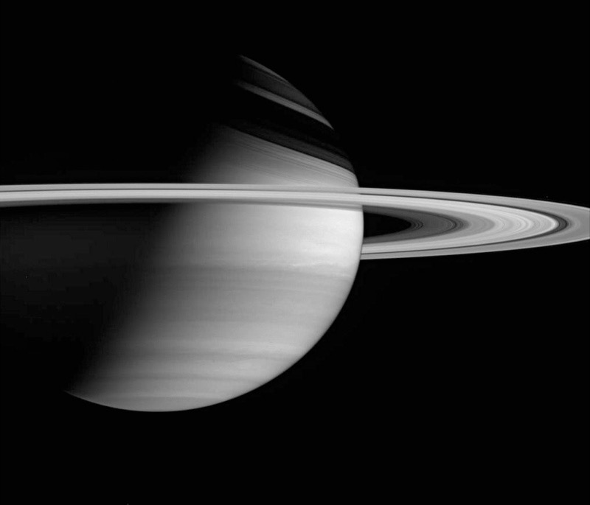
Notes:
Saturn is probably people’s favorite planet because of its rings, and if you ever see Saturn through a telescope you often can’t believe what you’re seeing is real. (My favorite planet, for what its worth, is Earth.) The rings are actually collections of rock and ice, but they form interesting patterns due to gravity from Saturn and from moons and material in the rings.
Also note the bands or strips in Saturn, similar to Jupiter. This is because Saturn, like Jupiter, Neptune, and Uranus, is mostly a slush of hydrogen and helium gas. Its more atmosphere than it is solid. These bands are actually the circulation of all this.
Incidentally, Galileo probably saw these rings, but he didn’t actually know what it was that he was looking at. He definitely noticed that Saturn had an oblong appearance to it.

Slide 13
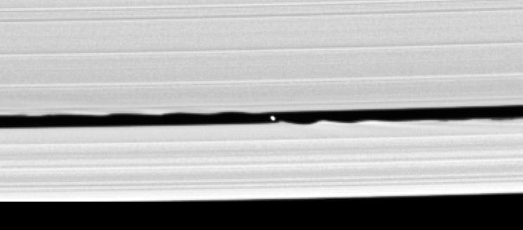
Notes:
This is a set of rings up close. Notice the gap, and notice that there’s a little rock pulling out material in this ring. It orbits in the same direction of the rings, but it goes a little slower than the material closer to Saturn (above in this photo), so you notice the “ripples” of material in the ring to the left, since this material has been tugged on my the rock as it passed. Similarly, the ripples are seen in the rings farther away, but on the right of this image, because the rock is orbiting faster and passing, leaving ripples behind as it has tugged on this debris.

Slide 14
Notes:
The New Horizons mission to Pluto offered lots of surprises. Pluto is small and should have cooled internally, thus limiting its geologic activity. And yet …

Slide 15
Notes:
especially when we look close we see wrinkly folding and the erasing of crater impacts that should surely have happened. So what gives? We don’t know. And that’s really exciting.
see http://pluto.jhuapl.edu

Slide 16
Notes:
There’s lots of other important stuff out there in our solar system besides planets. This is a comet, showing off both a dust tail (white) and an ion tail (blue). Ions are just charged particles that are shoved off by charges spit out by the Sun, known as the solar wind. The dust is released as the comet gets closer to the Sun and, as a result of more heat, starts to vaporize. (Instead of a dust tail, we might think of this as a vapor tail.) Comets are known as “dirty snowballs,” spending most of their time much farther from the Sun than planets, so the ice remains frozen. They’re only a few miles across, so they’re difficult to detect (especially since they’re so far away most of the time) until they get closer to the Sun and show these tails.

Slide 17
Notes:
A comet up close! Notice how parts exposed to the Sun’s light are vaporizing.

Slide 18
Notes:
Asteroids are rocky objects that spend most of their time much closer to the Sun than comets. In fact, most of them have a known area of where they’re most likely. One of these is the asteroid belt in between Mars and Jupiter. If you plot all of the known asteroids, they look like they’re clogging up our solar system, but really if you were to travel through you would probably never see one. Why is this? (The scale of the size of the asteroid, hundreds of feet across to a few miles) is very small compared to the hundreds of millions of miles of space they’re spread across. You just wouldn’t be able to see the dots if we made them to this scale.) Still, monitoring asteroids is important because we do NOT know where they all are, and there are known orbits of asteroids that intersect with Earth’s orbit. Exciting!

Slide 19
Notes:
This gives a sense of the scale of the locations of various “dwarf” objects in our solar system. Most asteroids are in orbits similar to Earth and Mars. Most comets are in orbits that are in all directions, much much farther from the Sun than all other objects in the solar system. And, a whole other class of planetary objects like Pluto are in the Kuiper (KEYE-per) Belt. When we reclassified Pluto, it wasn’t to demote it so much as to admit that there’s a whole other family of objects out there that Pluto belongs to.

Slide 20
Notes:
Here’s an artist’s rendition of planets in our solar system. It’s beautiful, but it’s wrong! How? (Think about scale.)

Slide 21
Notes:
Here’s an actual photo taken from a probe orbiting Saturn. (See the rings?) That little dot you see in between some of those faint outer rings -- what’s that? A moon? Some other small object around Saturn? Maybe something else? The inset image (upper left) is this dot, magnified. See that it has one other little bump, blurred together?
This little dot is actually Earth. It’s a lot different than the artist’s rendition!

Slide 22
Notes:
This is a photo taken with a digital SLR camera on a tripod by Dan Schroeder, physics professor at Weber State. Nothing here is magnified (as with a telescope), but simply taken by leaving the shutter open and steady for several seconds. This shows us that there’s lots more in the sky than what we see, and much of astronomy is done simply by collecting more of this dim, distant light.
This particular image shows a section of the Milky Way and a feature known as the pipe nebula. Can you see it?

Slide 23
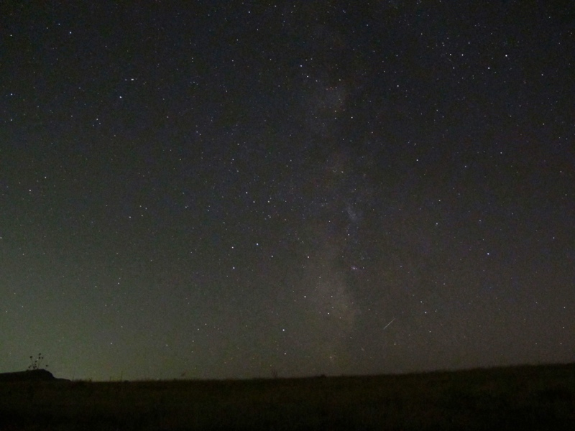
Notes:
Adam Johnston took this photo with a compact digital camera and a small, table top tripod that was sitting on the hood of his car while on Antelope Island for a star party. This shows Sagittarius, or the tea pot constellation, next to the Milky Way. There’s also a small streak that shows (I think) a satellite that was creeping across the sky during this 15 second exposure. The extra light in the photo is provided by light pollution of Davis County and Salt Lake City.

Slide 24
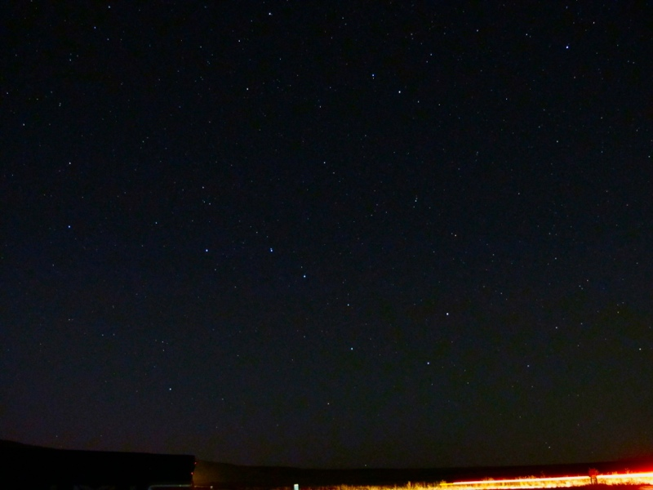
Notes:
Another 15 second exposure of Adam’s small camera. This was taken in the Uintas, far from city lights. Can you see the Big Dipper?

Slide 25
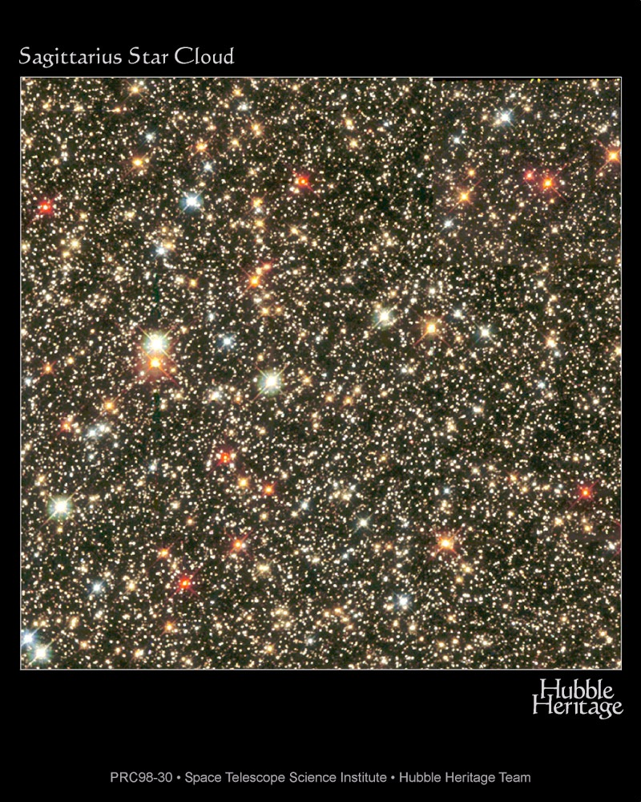
Notes:
This telescopic view shows that stars come in lots of different colors. Color, or the spectral class of a star, tells us how hot a star is.

Slide 26
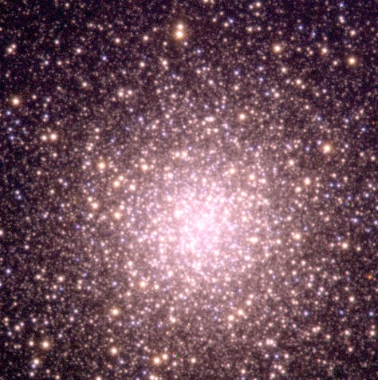
Notes:
This collection of stars is known as a globular cluster. These are interesting to study because all these stars are about the same age. The orbit in patterns that go outside of the disk of our galaxy, but still orbiting around.

Slide 27
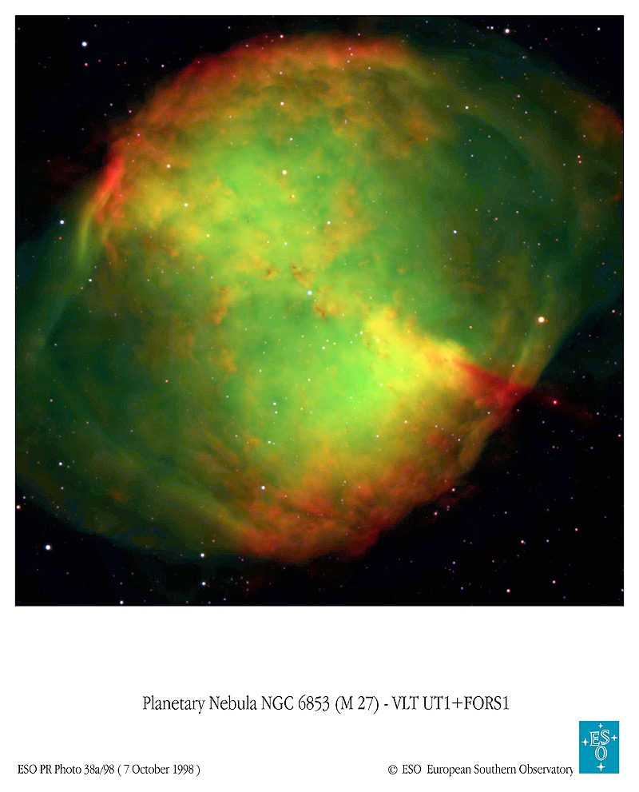
Notes:
Stars “die” in very interesting and varied ways. There are many examples of middle-weight stars known as a planetary nebula. (We only call them “planetary” because they were once mistaken for planets, because of their broad shape through a telescope.)

Slide 28
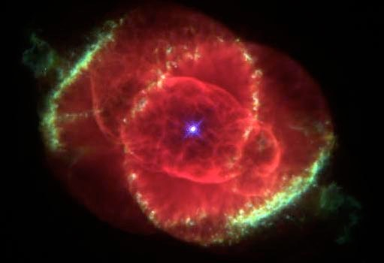
Notes:
Planetary nebular take on lots of different patterns and shapes. Trying to figure out why they do this is an active line of research. Dr. Stacy Palen is an astrophysicist at Weber State who studies these varied shapes and their causes.
This is the “cat’s eye nebula.”

Slide 29
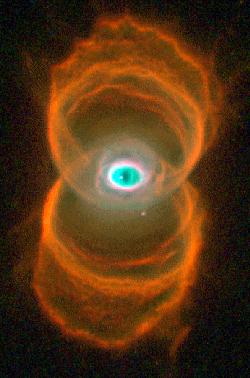
Notes:
And yet another planetary nebula, of another shape. What would you suppose is a cause for this? And what would you name this planetary nebula? (Hourglass Nebula)

Slide 30
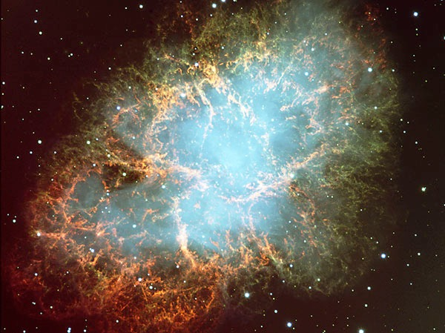
Notes:
This is known as the Crab Nebula. It’s much more scattered and was the result of a much more violent explosion of a star, known as a supernova. These explosions take place for the very largest stars, at least 10 times larger than our Sun. Because they were so much bigger, they were able to pressure together and create many of the elements in the periodic table; and the remnants of these kinds of stars provided the materials that make up our own Sun, our own planet, and even our own selves!

Slide 31
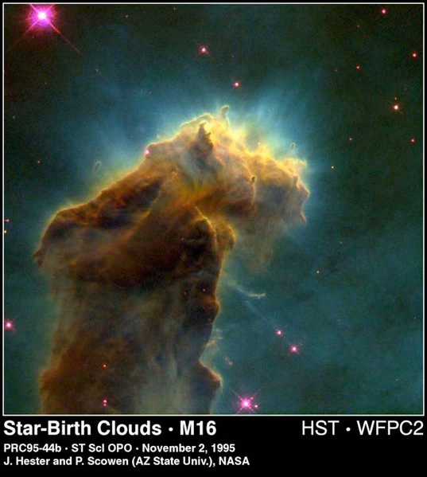
Notes:
The Eagle Nebula (up close) shows pillars or fingers of materials that are being whittled out by the heat that’s generated as material is being pulled together by gravity. The tips of those fingers are each a potential solar system!

Slide 32
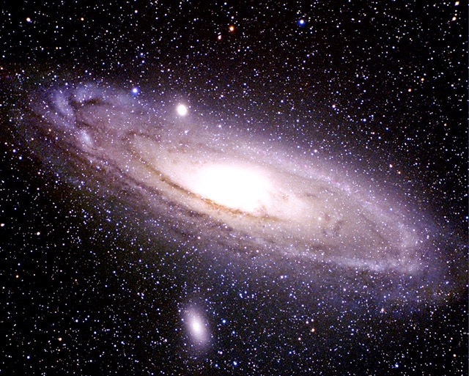
Notes:
If we take a step back even further, we begin to see entire continent-like structures of stars, known as galaxies. There could be hundreds of billions of stars in each galaxy. This one, the Andromeda Galaxy, looks very similar to what we think our own galaxy looks like. The Andromeda Galaxy is the NEAREST major galaxy, but even being so “close” it still takes the light from this major metropolis of stars about 2 million YEARS to get from there to here. (In other words, we’re seeing the galaxy as it existed two million years in the past! We’re looking back in time as we look farther away, because of how long it takes light to travel these great distances. Even our own Sun shows us light that is 8 minutes old.)

Slide 33
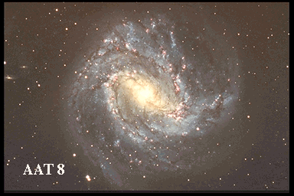
Notes:
Galaxies come in lots of interesting patterns. This one shows how bars and spirals can extend from a central bulge -- very similar to what our galaxy’s structure is. We are about halfway out on one of the arms.

Slide 34
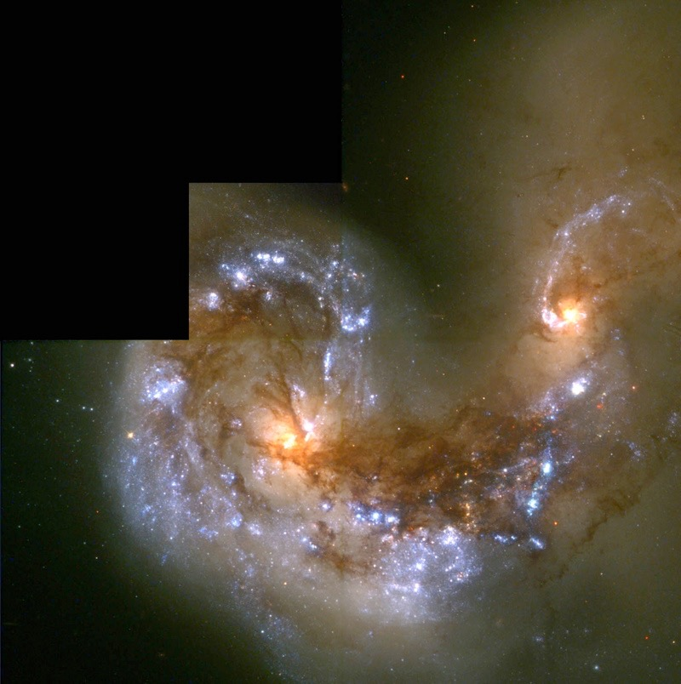
Notes:
Galaxies can collide! They have all the gravity of all those stars, and as such they naturally rotate around one another, cluster about, and sometimes even move through one another. What would this be like if our galaxy was moving through another one? Probably you wouldn’t even notice, since the stars are still so spread out compared to the scale of our solar system. (The closest star in our galaxy to the Sun is about 5 light years away; and remember that the Sun is only 8 light MINUTES away from Earth.) Still, this gives us a good sense that the universe has lots of interactions that can take place on a grand scale.

Slide 35
Just how big is space?
Look up . . .
Imagine a pencil tip . . .
Held out at arm’s length:
Notes:
Do this, or imagine it. Imagine how much sky your pencil tip will cover up -- not very much! Now, imagine all that might be behind that small pencil tip of sky ...

Slide 36
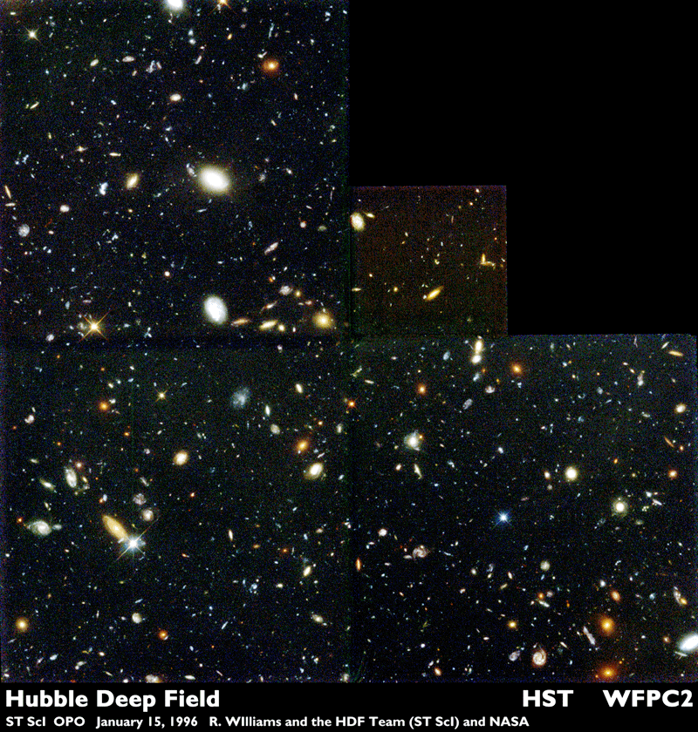
Notes:
This is what is in that little pencil tip! Each one of these objects is an entire galaxy! (Each with 100 billion stars!) And, this isn’t a special part of the sky -- in fact we just picked this one for the Hubble Space Telescope because nothing in our own galaxy was in the way when we took this picture of other galaxies. Every pencil tip of the sky looks something like this. This should give you a sense of how much is out there, and how small we really are ...

Slide 37
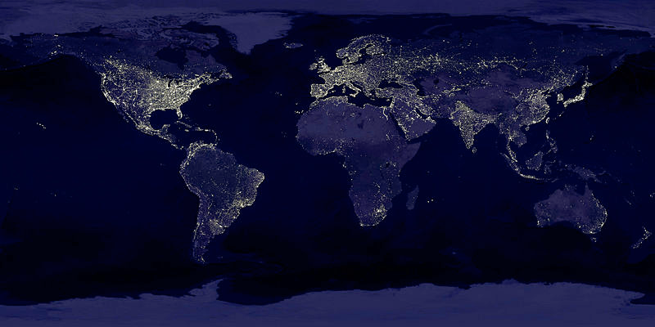
Notes:
... but, we’re the only place we know of that looks like this. We are doing something relatively amazing. We are not just making stuff, but we are actually aware of ourselves and our universe. We’re producing lots of light (not always such a good thing), but we’re also the only thing we know of in the universe that is looking at all the other lights out there and pondering what it all means. In a sense, the universe is only as aware of itself as we are. Maybe its our responsibility to pay attention.

Slide 38
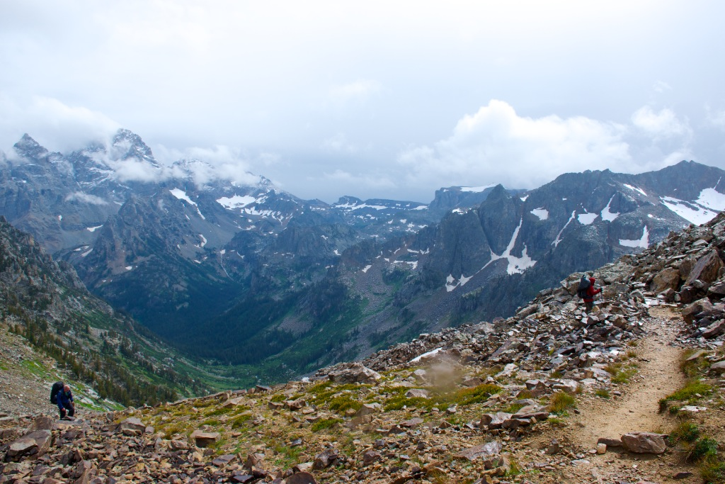
The Moral:
Notes:
I chose this picture because it’s a good example of just how amazing some very basic things are. First, there’s water (in all three phases!), vegetation, air ... things that we only have here on Earth. And then there’s this collection of humanoids outfitted with camp stoves and tents and backpacks and rain gear, making the way up from that glacial valley to this divide (Paintbrush Divide in the Grand Teton NP). Maybe most important, this place provides not only a way for us to exist, but to be conscious of our own existence, all the other stuff that’s around, and how impossible that might all seem. I’d like to think that we should feel some sense of responsibility to the natural world. It gives us the possibility to be aware of it all, and we should follow up on this as well as take care of all that we have.

Slide 39
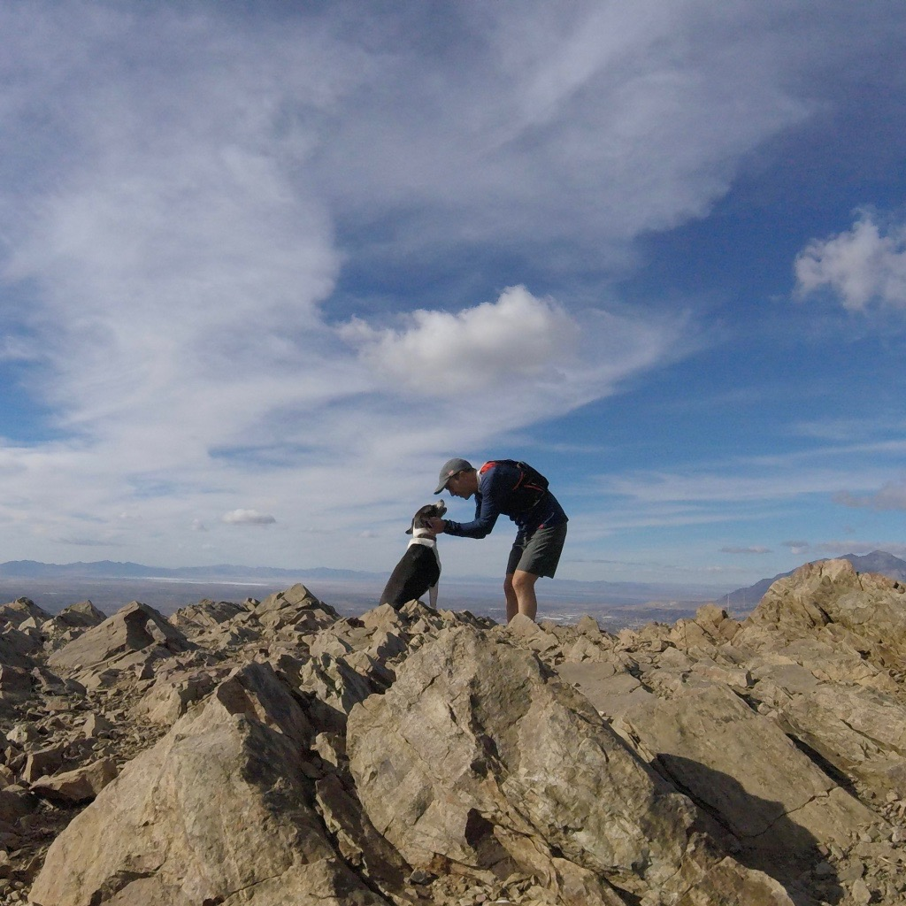
The Moral:
Notes:
And, also, here’s me and my dog after running up Malan’s peak. :-)

